Slide 1
INDIAN FOOD
TS- WEB/CC/AI TRACK CAPSTONE PROJECT
Presented By:
SHAFREEN BANU.P – B.SC., COMPUTER SCIENCE
2. DIYANA RISHMI.M – B.SC., COMPUTER SCIENCE
3. PAVITHRA.K – B.SC., COMPUTER SCIENCE
4. JARIYA BEGUM.K – B.SC., COMPUTER SCIENCE
Guided By:

Slide 2
OUTLINE
Abstract
Problem Statement (Should not include solution)
Aims , Objective & Proposed System/Solution
System Design
System Development Approach(Technology Used)
Algorithm & Deployment
Conclusion
References
Future Scope

Slide 3
Abstract
Sweets are part of any Indian celebration or festivity of any kind. They are prepared in Indian households not only for special feasts and occasions, but also for simple celebrations like birthdays, anniversaries, graduations or even any other concocted reason. Sweets are symbol of good gesture in India. One can get a beautiful scene of colourful sweets in any Indian sweet shop.
In our project we are going to see the results with the help of linear regression.In Indian sweets project, we have x values and y values.If we give the x values of Index, prep_time,quality_g and we can get the y values of cook_time and rate_rs.

Slide 4
Problem Statement
In our project we are going to see the results with the help of linear regression.In Indian sweets project, we have x values and y values.If we give the x value of Index, prep_time,quality_g and we can get the y values of cook_time and rate_rs.

Slide 5
Proposed Solution
In this study, Indian food dataset is considered. this dataset has discussed in methodology section. The proposed methodologies are evaluated with a dataset obtained from the Kaggle online source.Before applying the machine learning model, we have analysed the Indian food dataset based on e of food and type of dishes parameters. Before this, we first found the number states for each category of food as 2.The number of vegetarian and vegetarians states.

Slide 6
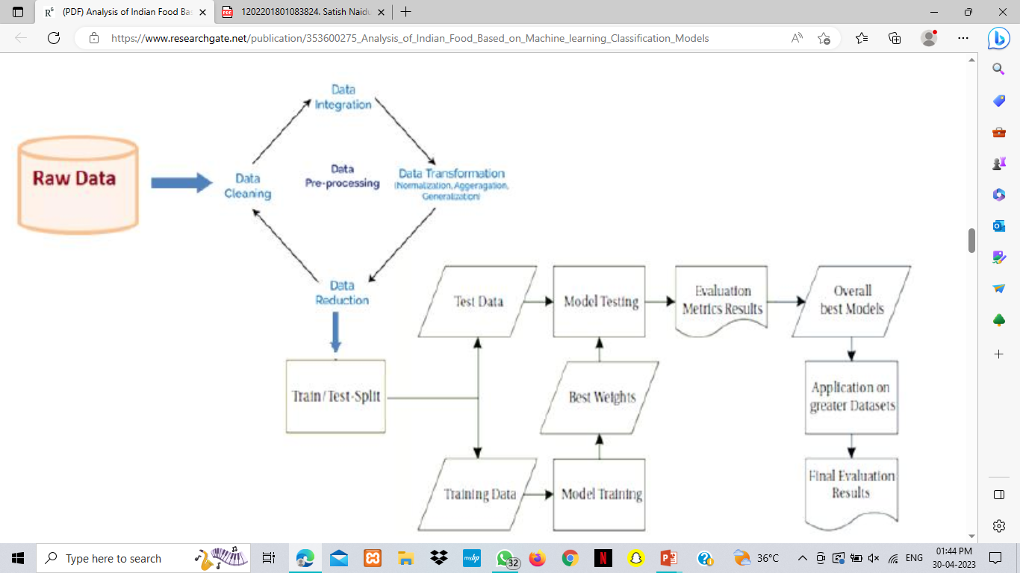
System Architecture

Slide 7
System Deployment Approach
The differential growth experience of Indian states can be explained by their initial investments in agricultural productivity growth and their subsequent focus on robust non-agricultural employment growth.Meeting the growing urban demand for food and other agricultural products and non-farm employment provides new growth opportunities for rural economies; the challenge is to ensure that it is inclusive of the poor.Diet transition and the rising demand for food diversity is not matched with a commensurate rise in the supply of non-staple foods leading to poor access to more nutritious food.

Slide 8
Algorithm & Deployment
In this study, Indian food dataset is considered as the dataset for all proposed machine learning methodologies. This dataset contains 50 numbers of records with 9 numbers of attributes or features. Prediction of Indian food can be made using parameters like, name, ingredients, diet (Vegetarian or Non vegetarian),preparation time, cook time, flavour of food (spicy, sweet etc.), course, state, region,quantity and rate. In this article, we have considered the following machine learning models to predict the Indian food. They are K-Nearest Neighbour (KNN), Decision Tree, Random Forest (RF), and Support vector Machine (SVM) models. These four machine learning models are supervised machine learning models.We have implemented the above four models for classification experimentally and compared with each other to find the highest accuracy.

Slide 9
Reference
https://www.researchgate.net/
https://scikit-learn.org/stable/modules/neighbors.html#regression

Slide 10
Future Scope
The experimental results are compared by the most popular machine learning model for classification and prediction of Indian food. All models have their own advantages and limitations, but the toughest work is to choose the best model. From these observations,it concluded that works well to predict and classify the Indian food.
For this Indian food database may be classified better with more accuracy, if any hybrid model is used. Hence, in future work a hybrid modelwill develop for this database to get the higher and better accuracy.

Slide 11
THANK YOU

